Slide 1
Deploy Three-Tier Architecture in AWS using Terraform.
M.Niteesh chandra

Slide 2
Contents
*Introduction
*Architecture
*Workflow

Slide 3
Introduction:
Git:
Git is a version control system.
Git helps you keep track of code changes.
Git is used to collaborate on code.
Terraform:
Terraform is an Infrastructure as Code (IaC). Terraform is a tool for building, changing and versioning infrastructure safely and efficiently. Terraform is an open source infrastructure as code software tool that provides a consistent CLI workflow to manage cloud services

Slide 4
AWS:
AWS is a comprehensive, easy to use computing platform offered Amazon. The platform is developed with a combination of infrastructure as a service (IaaS), platform as a service (PaaS) and packaged software as a service (SaaS) offerings.
It is a platform that offers flexible, reliable, scalable, easy-to-use and, cost-effective cloud computing solutions.

Slide 5
Three-Tier Architecture:
A 3-tier application architecture is a modular client-server architecture that consists of a presentation tier, an application tier and a data tier.
Application Tier: The application tier, also known as the logic tier or middle tier. In this tier, information collected in the presentation tier is processed. The application tier can also add, delete or modify data in the data tier.
Presentation Tier: It is a graphical user interface (GUI) that communicates with the other two tiers
Data Tier: The data tier, sometimes called database tier, data access tier or back-end, is where the information processed by the application is stored and managed
The three tiers are logical, not physical, and may or may not run on the same physical server.

Slide 6
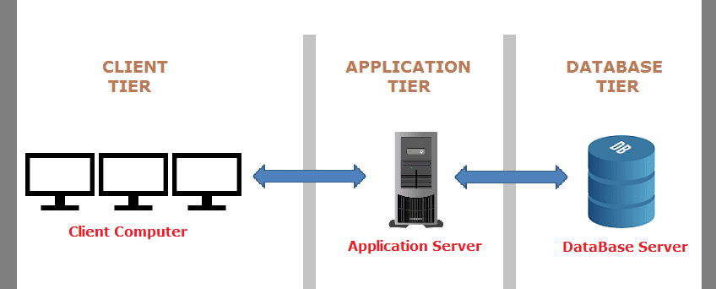
Three-Tier Architecture

Slide 7
Providers:
Each resource type is implemented by a provider, which is a plugin for terraform that offers a collection of resource types. Providers are distributed separately from terraform itself, but terraform can automatically install most providers when initializing a working directory. Every terraform provider has its own documentation, describing its resource types and their arguments

Slide 8
Sample:
provider "aws" {
region = "ap-south-1"
access_key = “XXXXXXXXXXXXXXXXXXXXXXXXXXO3"
secret_key = “XXXXXXXXXXXXXXXXXXXXXXXXXXJLK"
}

Slide 9
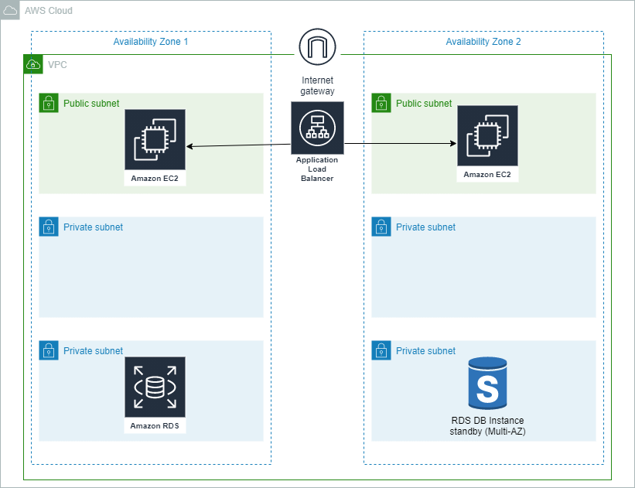
Architecture

Slide 10
Workflow
EC2
Terraform
AWS
Terraform init
Terraform apply
Terraform validate
Sample.tf
GIT
Git Push
Sample file
Acts as a backup

Slide 11
Sample file: vpc.tf
resource "aws_vpc" "my-vpc" {
cidr_block = "10.0.0.0/16"
instance_tenancy = "default"
tags = {
Name = "my-vpc"
}
}

Slide 12
Working
EC2:
*Install Terraform in EC2
*The sample file is created in EC2
*Then we use “terraform init”, “terraform validate” commands to initialize and validate the file.
Terraform:
*”terraform approve” or “terraform approve –auto-apply” to create the infrastructure in AWS.

Slide 13
AWS:
*The infrastructure is created in AWS
*If we use “terraform destroy” the infrastructure we created is destroyed.
Git:
*If we push the files to the github then we don’t have to worry about files deletion. It will act as a backup

Slide 14
Thank you

